Slide 1
CAR RESALE VALUE PREDICTION
Team name: Fab 5
Team Members:
J.Manisahithi
S.Pranathi
T.Manisha
J.Pausha
T.Harathi

Slide 2
Project Overview
Problem :
Used cars sales are on global increase.There is a need for used car price prediction system to effectively determine business finance and customer purchase.
Solution:
A model can be developed to predict and assign that price to the vehicle.
To effectively determine the worthiness of used car by studying variety of features.
Result:
To predict the actual market value considering various characteristics that helps both buyers and sellers.

Slide 3
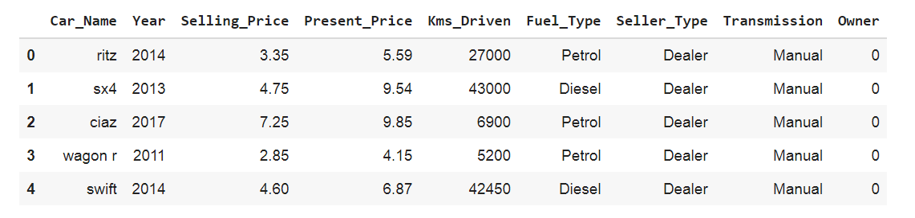
Dataset Collection:
For accurate and real time analysis, dataset is collected from Kaggle site.
After collecting save it as .csv file in drive.
It contains 9 columns and 301 rows.

Slide 4
Data Preprocessing
Data preprocessing means we will be preprocessing the dataset that is collected. Preprocessing includes:
Handling the null values.
Handling the categorical values if any.
Normalize the data if required.
Identify the dependent and independent variables.
Split the dataset into train and test sets.

Slide 5
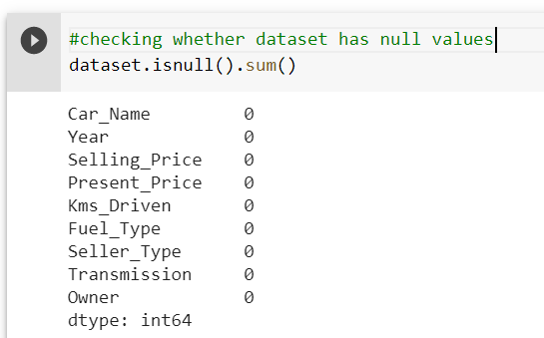
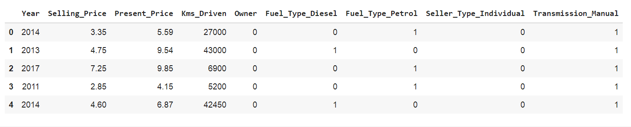
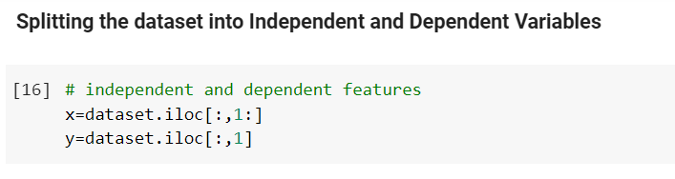

Slide 6
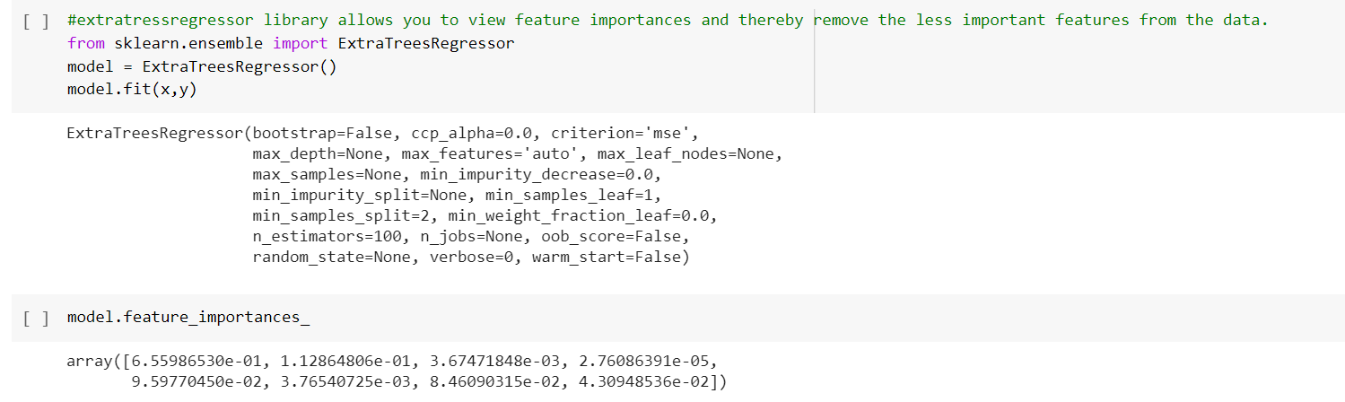
Finding out feature importance to eliminate unwanted features The extratressregressor library allows you to view feature importances and thereby remove the less important features from the data. It is always advised to remove the unnecessary feature because they can definitely yield better accuracy scores.

Slide 7
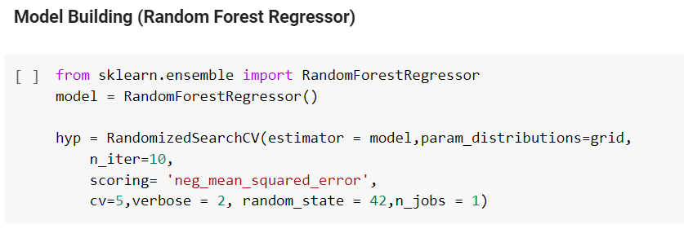
Model Building
In regression analysis, model building is the process of developing a probabilistic model that best describes the relationship between the dependent and independent variables.
There are several Machine learning algorithms to be used depending on the data you are going to process such as images, sound, text, and numerical values.
We are choosing Random Forest Regressor model to build the model. Because, Prediction based on the trees is more accurate because it takes into account many predictions. These algorithms are more stable because any changes in dataset can impact one tree but not the forest of trees.

Slide 8
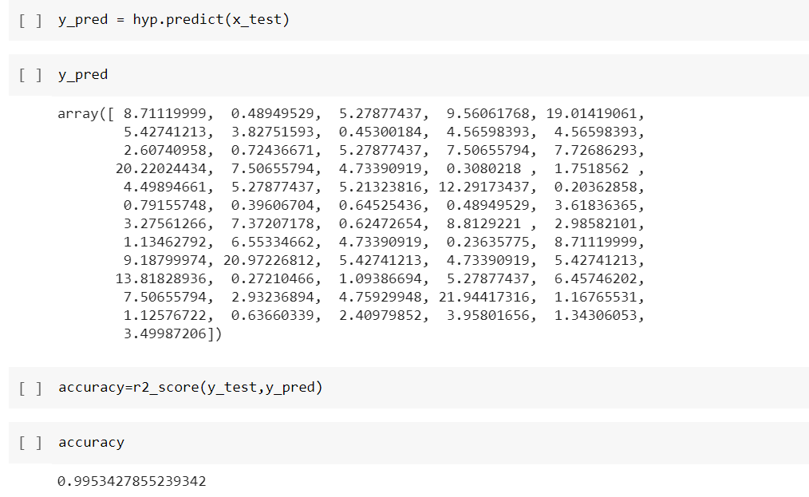
Next we will be evaluating the model built. We will be using the test set for evaluation. The test set is given to the model for prediction and prediction values are stored in another variable called y_pred.
Next we predict the data and find accuracy.

Slide 9
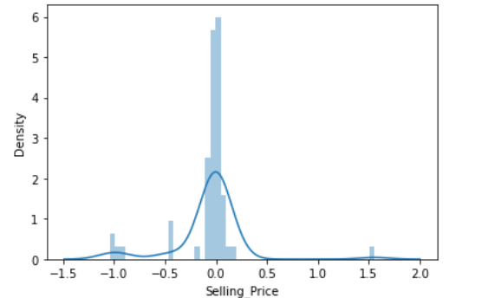
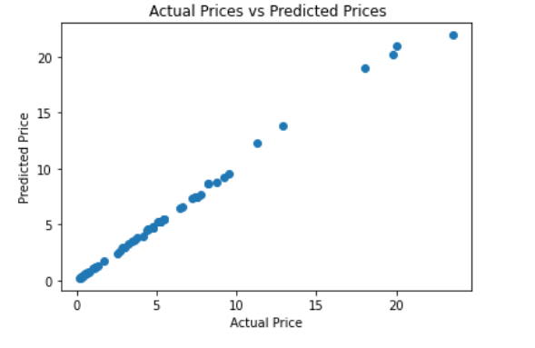
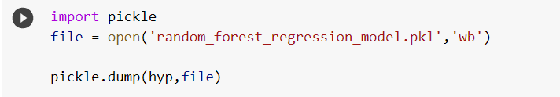
Data visualization
Saving the Model To use the Flask framework for deployment, it is necessary to pack this whole model and import it into the python file for creating web applications. Hence we dump our model into the pickle file using the given code.

Slide 10
Application Building
Steps to build the application:
Create a folder called flask and import pickle file to it
Install Anaconda
Launch Spyder
Write the program code and save it as .py in flask folder
And also write html code on project and save it as .html in templates which is in flask folder
Open Anaconda Prompt and copy the flask path
Run the code
Open google and run http://localhost:5000 or http://127.0.0.1.5000/
We get the webpage we created
Enter the input values and calculate the selling price.

Slide 11
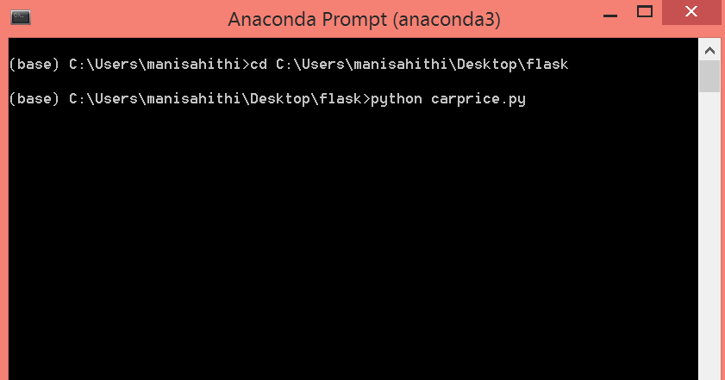
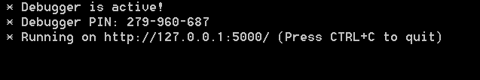
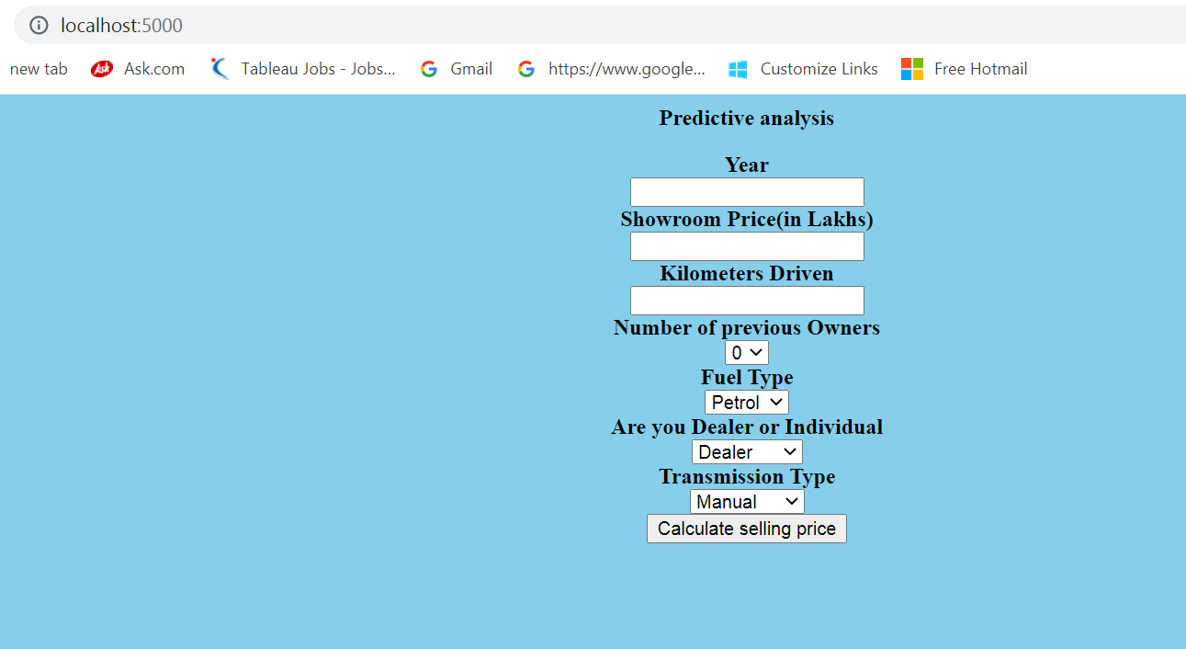

Slide 12
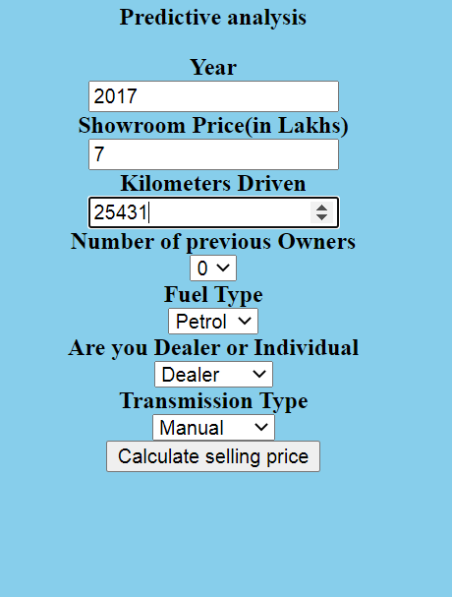
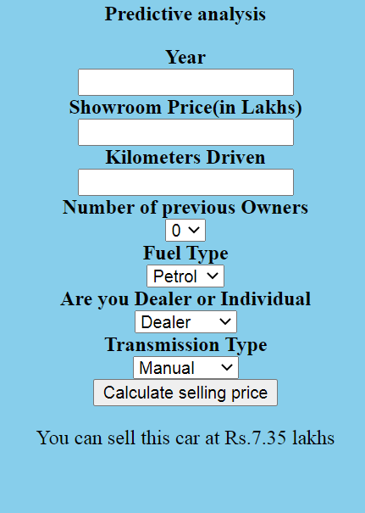

Slide 13
THANK YOU

